Slide 1


LIVING THE GOOD LIFE
TEAM 4:
CHITTI, SAI
CUI, CHUNYI
LIU, CHANG
SRIHA, MO
YUAN, XIN
EAT SMART. IT PAYS!

Slide 2
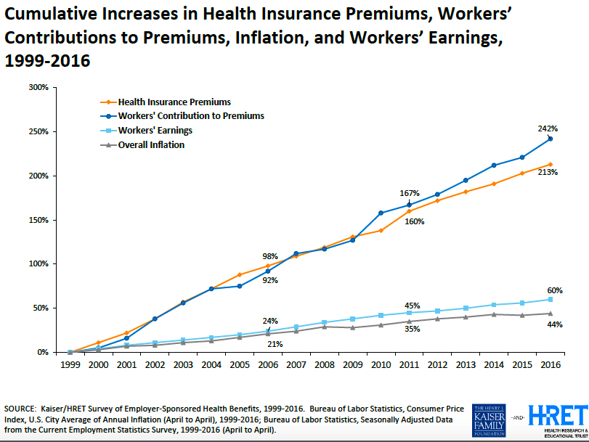
PROBLEM
Insurance premiums are increasing by the year
Healthy people are paying too much!
Notes:
Healthy people are paying for the unhealthy..
Limitations in the current system - Only tobacco is being considered
Take the graph from appendix. Explain why the hike in healthcare rates increases the tax rates.
How can we improve the general health of our clients?
Encourage UPMC clients with a healthy lifestyle to continue doing better.
Incentivize the unhealthy clients to eat healthy and exercise more.
Checks stress levels [Source: lifetothefullest]
Obesity.
Diabetes
Increase in saturated fat/bad cholesterol levels
Fast foods are loaded with sodium

Slide 3

Current solution
Are there better parameters?
How do we improve the reliability of our observations?
Yes! What’s more?
More scientific!
Notes:
Not effective enough
How do you trust the data you capture? Is it reliable?

Slide 4

Notes:
In a nutshell, what’s UPMC trying to say to its clients? We are helping them realise this!
Give me an opportunity to help you!
Jerry Maguire’s tag line is UPMC’s motto for now.

Slide 5

Solution
Idea: Incentive-based system
Reward healthy people by reducing their healthcare insurance costs
Encourage others to improve their lifestyles
Capture people’s dietary data via images, analyse it and rate their dietary habits.
Isn’t this too expensive?
Cloud Computing!
That’s where we come in!
Notes:
What’s their solution?
Help UPMC save money so they can help their clients save some money
Hire engineers, and analyse the huge amounts of user data; classify clients and give out incentives.

Slide 6
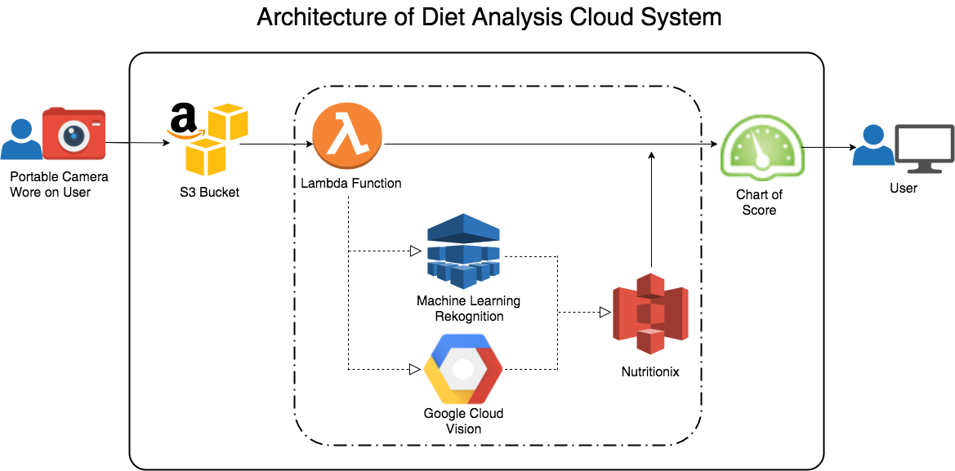
ARCHITECTURE OF OUR SYSTEM
Notes:
CLOUD!
Prototype doesn’t contain the camera. We simulated the functioning of the camera through a bucket.
Lambda functions trigger different responses to events that they respond to
Score is computed using an API
First, it’s on cloud. Second, we are using a very cost effective way for the computations done on the cloud

Slide 7
But why choose our team, indeed?
Solid system in place! This is why our system stands out:
2 Image Recognition APIs → Amazon’s Rekognition, Google Cloud Vision
Nutritionix API to get more reliable scores for the labels
Score based on the calories, carbs, fiber, and protein quantities that the client has had for his meal!
Cost Upfront for building the system: $24,800
Recurring cost: $424/month
Notes:
This is the part in our system that shines!
We know that UPMC has other people vying for the contract. Why choose us?
Determine who’s healthy and who’s not on more accurately.

Slide 8
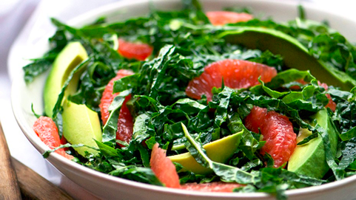
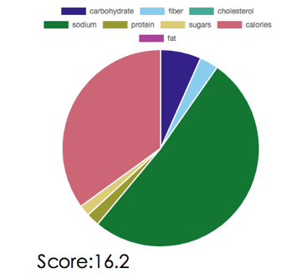
Example:
Dish 0
Salad 26.0
Leaf vegetable 70.9
Vegetable 115.8
Produce 115.8
Spinach 198.1
Vegetable 243.0
Food 243.0

Slide 9

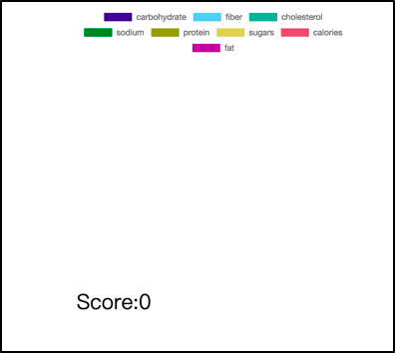
Example: Non-food Image
Dishware 0
Fork 0
Cutlery 0
Porcelain 0
Cutlery 0
Fork 0
Glass 0
Dish 0

Slide 10
Thank you!

